Slide 1
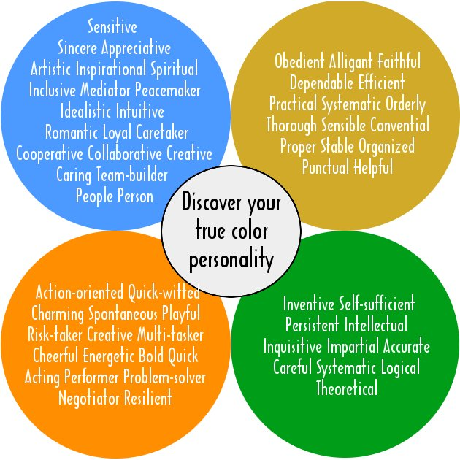
True Colors
By: Bruno Deni
MY

Slide 2
Enjoy!

Slide 3
Me!
My true color is green!
Green means you are intelligent, self sufficient, inquisitive, detached, and believe work is fun.
One reason I’m green because I don’t just listen to music, when I really like a band I usually research the band to find out facts about them. I do that a lot because I think it is fun to get more information about the things and concepts I am interested in.

Slide 4
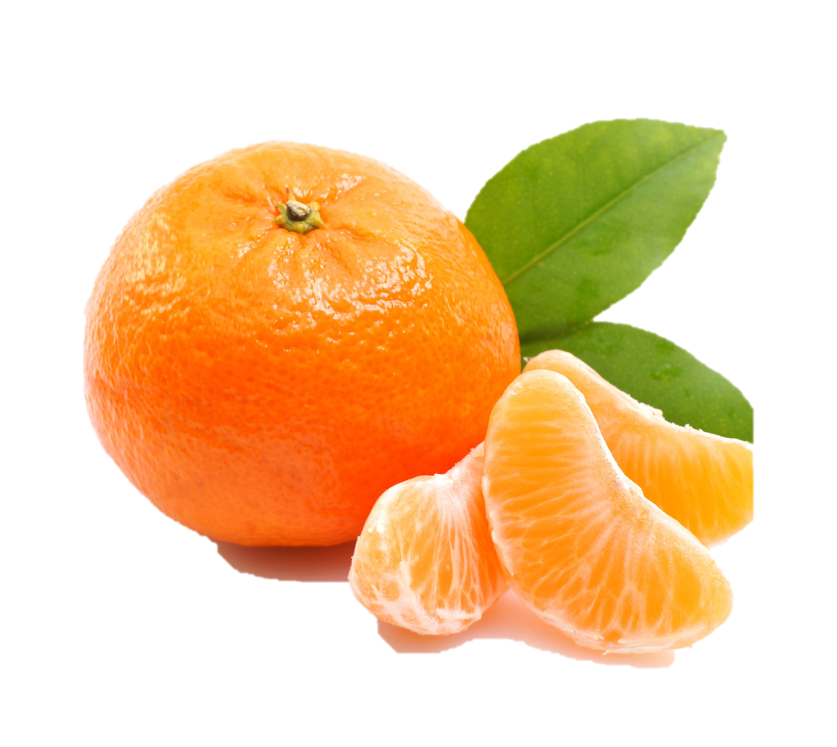
Orange!
The color I will talk about now is orange.
Orange people are competitive, exciting, bold, social, optimistic, free, generous, and active risk takers.
One orange person I know is Adam, my guitar teacher.
An example of why Adam is orange is when he decided to teach the Evolution of Metal program. He did not know if the program would fail or if the group of kids would be bad and annoying.

Slide 5
blue
The color I will talk about next is blue.
Blue people are emotional, nurturing, creative, honest, polite, adaptable, involved, and caring friends.
One blue person I know is my mom.
One way My mom is a blue is because every year my mom makes an apple pie for my brother on his birthday. Now this doesn’t sound like much but my brother is highly allergic to many different foods so that means my mom can’t use any wheat, dairy, or eggs. This means that every year my mom has to struggle in the kitchen for hours, a thing that only a blue person would do.

Slide 6
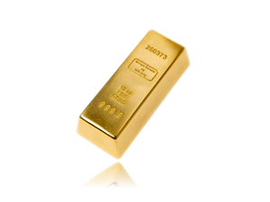
Gold
The color I will now talk about is gold.
Gold people are organized, goal-oriented, scheduled, responsible, prepared, structured, stable, punctual, and hard workers.
One gold person I know is my Dad.
A reason why my father is gold is he always has his “secret room” organized. His secret room is a closet with a bunch of items that mean something to him. Whenever I go in there (which is rarely) I always see everything packed up neatly in a drawer or on a shelf. When I ask to see something in the room he can always get it for me quickly because he knows where everything is.

Slide 7
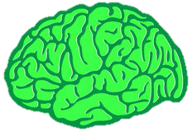
Green
The final color I will be talking about is green
Green means you are intelligent, self sufficient, inquisitive, detached, and believe work is fun.
One Green person I know of is Marie Curie
One way that marie curie is green is that she discovered radium. Not many people in other colors would use their time and brain power to discover something let alone be curious about the topic.

Slide 8
THE END

